Slide 1
Programming Assignment 3: Image Segmentation
Dr. Tsung-Wei Huang
Department of Electrical and Computer Engineering
University of Utah, Salt Lake City, UT

Slide 2
Goal
Understand the image segmentation problem
Relate segmentation problem of maxflow
Write algorithms to solve the problem

Slide 3
Image Segmentation
Separate the foreground from the background

Slide 4
Setup
Image is a grid of pixels
Need to decide which pixels are in the foreground
Others are in the background
Applications provide likelihood value of each pixel v
f_{v} : Likelihood to be in the foreground
b_{v} : Likelihood to be in the background

Slide 5

Simple Version of the Problem
Input: values a_{v} and b_{v}
Partition pixels into sets F and B so that
$\sum_{v in F}{fv}$ $+\sum_{v in B}{bv}$ is maximized

Slide 6
Example
What is the best value for the following three pixels?
Pixel v | 1 | 2 | 3
f_{v} | 3 | 5 | 6
b_{v} | 4 | 3 | 5

Slide 7
Example
Greedy assignment can solve this problem …
4+5+6 is the maximum value we can get
Pixel v | 1 | 2 | 3
f_{v} | 3 | 5 | 6
b_{v} | 4 | 3 | 5

Slide 8
Nearby Pixels
Expect nearby pixels will be on the same divide line
Have penalty p_{vw} for each nearby pixel pair v and w:
v in foreground and w in background

Slide 9

Image Segmentation Problem
Input: values a_{v} and b_{v} ; penalty p_{vw}
Partition pixels into sets F and B so that
$\sum_{v in F}{fv}$ $+\sum_{v in B}{bv}−\sum_{v in F, w in B}{pvw}$ is maximized

Slide 10
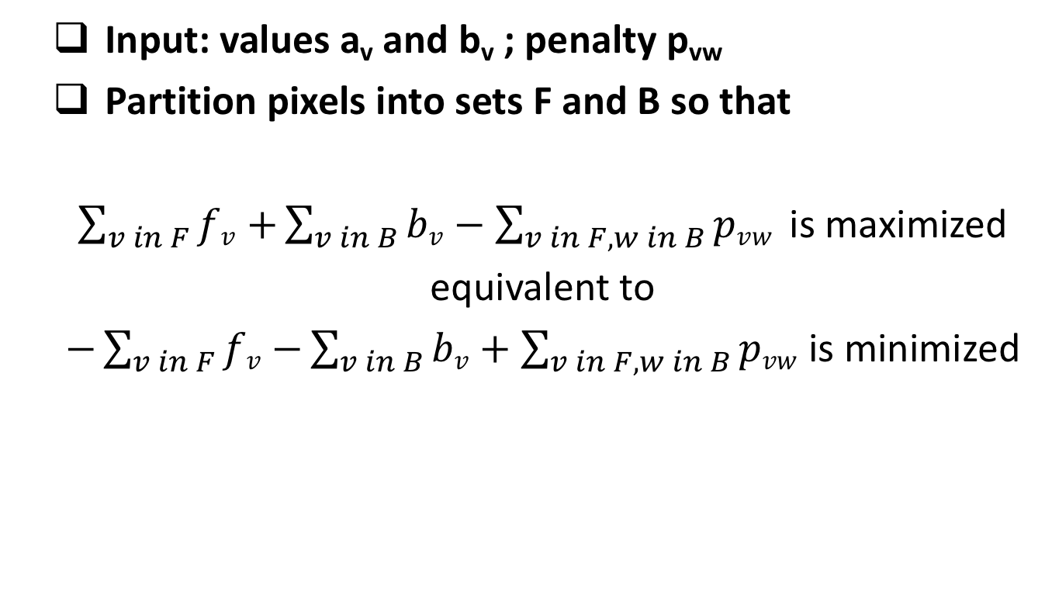
Transformed Formula
Input: values a_{v} and b_{v} ; penalty p_{vw}
Partition pixels into sets F and B so that
$\sum_{v in F}{fv}$ $+\sum_{v in B}{bv}−\sum_{v in F, w in B}{pvw}$ is maximized
equivalent to
$−\sum_{v in F}{fv}$ $−\sum_{v in B}{bv}+\sum_{v in F, w in B}{pvw}$ is minimized

Slide 11
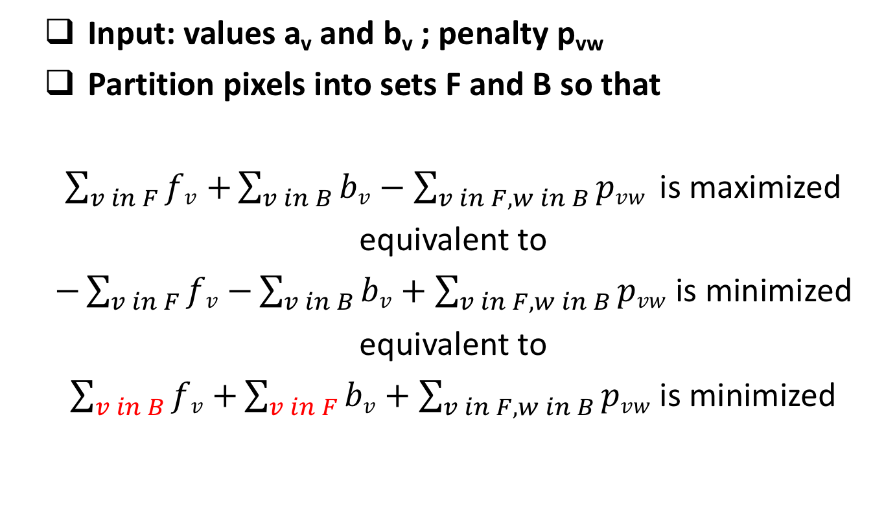
Transformed Formula
Input: values a_{v} and b_{v} ; penalty p_{vw}
Partition pixels into sets F and B so that
$\sum_{v in F}{fv}$ $+\sum_{v in B}{bv}−\sum_{v in F, w in B}{pvw}$ is maximized
equivalent to
$−\sum_{v in F}{fv}$ $−\sum_{v in B}{bv}+\sum_{v in F, w in B}{pvw}$ is minimized
equivalent to
$\sum_{v in B}{fv}$ $+\sum_{v in F}{bv}+\sum_{v in F, w in B}{pvw}$ is minimized
Pixel v | 1 | 2 | 3
f_{v} | 3 | 5 | 6
b_{v} | 4 | 3 | 5
Why? Because f_{v}+b_{v} is constant per pixel

Slide 12
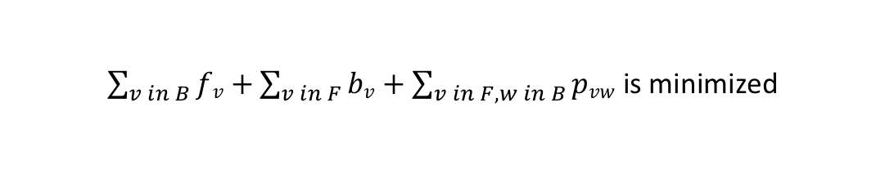
Idea
Observed
Want to split pixels to two disjoint sets
Pay cost based on boundary penalty
Looks like a min-cut
$\sum_{v in B}{fv}$ $+\sum_{v in F}{bv}+\sum_{v in F, w in B}{pvw}$ is minimized
B
Background
Foreground

Slide 13
Flow Network
New vertices s and t
Edge s to v with capacity f_{v}
Edge v to t with capacity b_{v}
Edge v to w with capacity p_{vw}
Edge w to v with capacity p_{vw}
f_{v}
s
v
p_{vw}
f_{w}
b_{v}
p_{vw}
W
t
b_{w}

Slide 14
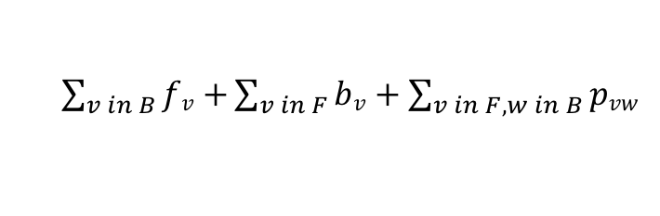
s-t Cut is the Best Segmentation
f_{v}
s
v
p_{vw}
f_{w}
b_{v}
p_{vw}
W
t
b_{w}
$\sum_{v in B}{fv}$ $+\sum_{v in F}{bv}+\sum_{v in F, w in B}{pvw}$

Slide 15
TODO Tasks
Visit https://vision.cs.uwaterloo.ca/data/maxflow
Download BVZ and KZ2 benchmarks (totally 6)
Each benchmark describes a flow network
Each benchmark provides a golden solution
Implement the following maxflow problem
Ford-Fulkerson with DFS in the loop
Ford-Fulkerson with BFS in the loop
Push-Relabel algorithm
Boykov-Kolmogorov algorithm
“An Experimental Comparison of Min-Cut/Max-Flow Algorithms for Energy Minimization in Vision”, IEEE Transaction on PAMI
http://www.csd.uwo.ca/~yuri/Papers/pami04.pdf

Slide 16
Fill the Table with Runtime Values
 | Ford-Fulkerson DFS | Ford-Fulkerson BFS | Push-Relabel | Boykov-Kolmogorov
BVZ-tsukuba
BVZ-sawtooth
BVZ-venus
KZ2-tsukuba
KZ2-sawtooth
KZ2-venus

Slide 17
Benchmark Format
Comment Lines: Comment lines give human-readable information about the file and are ignored by programs. Comment lines can appear anywhere in the file. Each comment line begins with a lower-case character c.
c This is an example of a comment line.
Problem Line: There is one problem line per input file. The problem line must appear before any node or arc descriptor lines. For maximum flow network instances the problem line has the following format:
p max NODES ARCS
The lower-case character p signifies that this is a problem line. The three-character problem designator max identifies the file as containing specification information for a maximum flow problem. The NODES field contains an integer value specifying n, the number of nodes in the network. The ARCS field contains an integer value specifying m, the number of arcs in the network.

Slide 18
Benchmark Format Cont’d
Node Descriptors: All node descriptor lines must appear before all arc descriptor lines. Node descriptors are of the form:
n ID WHICH
where ID is the node id and WHICH is s for the source and t for the sink. Two node descriptors, one for the source and one for the sink, must appear between the problem line and the arc descriptor lines.
Arc Descriptors: There is one arc descriptor line for each arc in the network. For a maximum flow instance, arc descriptor lines are of the following form.
a SRC DST CAP
The lower-case character a signifies that this is an arc descriptor line. For a directed arc (v,w) the SRC field gives the identification number for the source vertex v, and the DST field gives the destination vertex w. Identification numbers are integers between 1 and n. The CAP field gives the arc capacity.

Slide 19
Submission Instruction
Email the following to tsung-wei.huang@utah.edu
Compress your entire project to a tar ball or zip
A text or excel table summarizing runtime
4 methods x 6 benchmarks
We expect you to be able to start from scratch
Read and parse the input format (it’s actually very simple)
Build your own flow network data structure
Study the very famous computer vision paper (Boykov-Kolmogorov maxflow algorithm)
Due 4/29 (final exam week)

